Slide 1

REACT JS
- Tanmay Mutalik

Slide 2
Contents
Introduction
Architecture
Components, States, props
Conditional Rendering, Map, FIlter
Event Handling
Forms
Router

Slide 3
Introduction:
React is a JavaScript library for building frontend for Web/Mobile applications
Open source, Reusable Component based front end library
Single page application
Facebook launched react in 2013

Slide 4
Why React?
Easy creation of dynamic web applications
Performance enhancement
Reusable Components
Unidirectional data flow
Can also be used for mobile apps

Slide 5
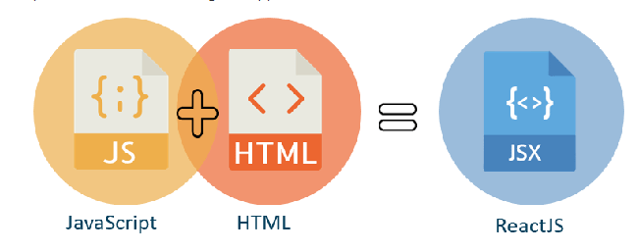
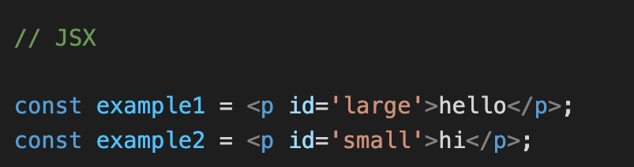
JSX - Javascript syntax extensions
JSX is a syntax extension to JavaScript
By using JSX, you can write the HTML structures in the same file that contain Javascript codes

Slide 6
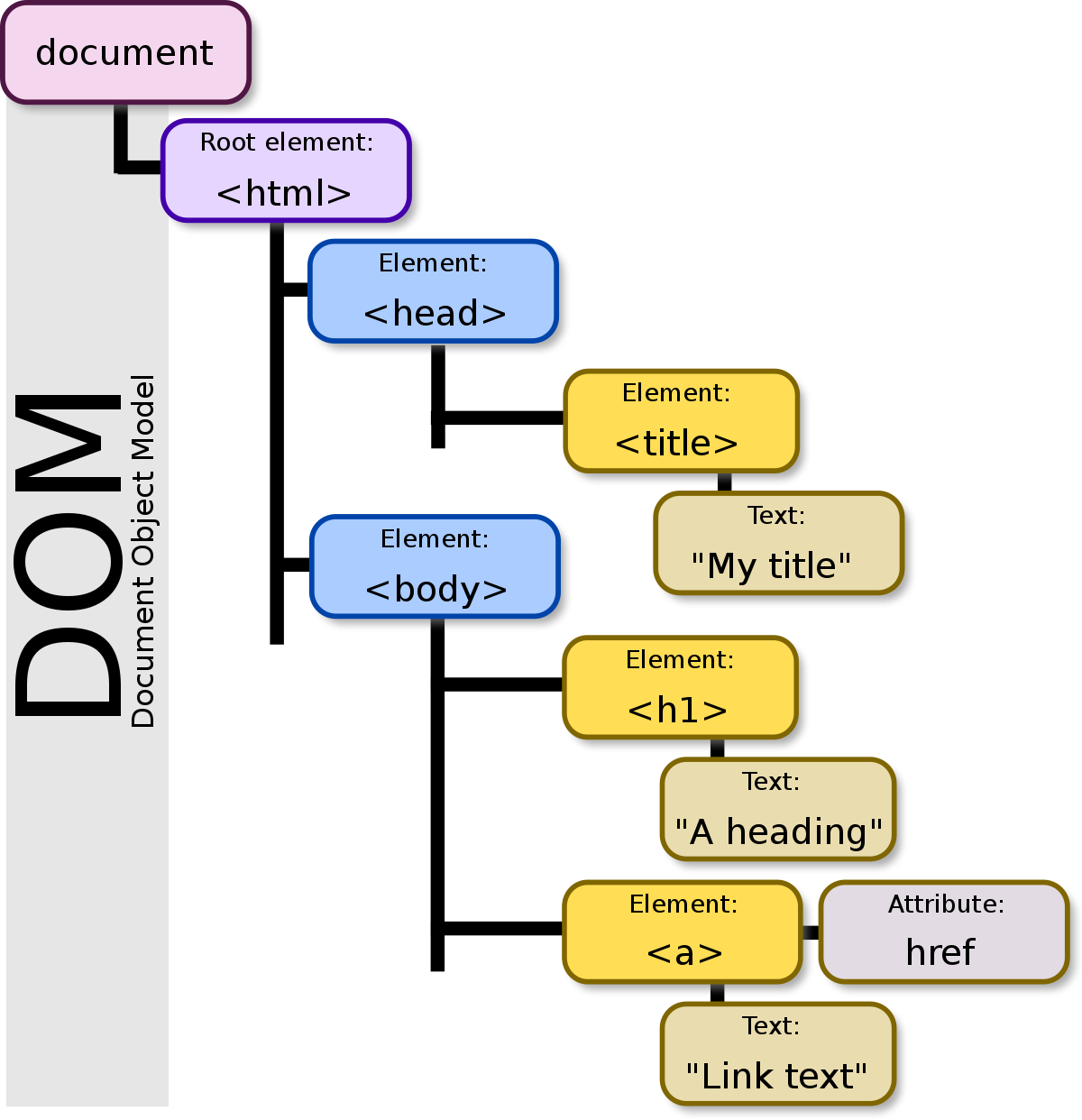
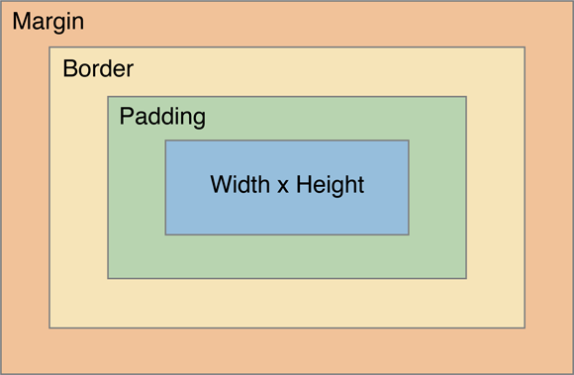
CSS Box Model

Slide 7
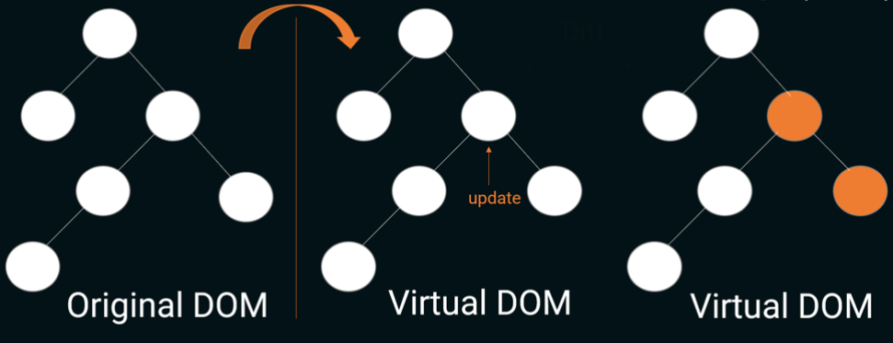
Virtual DOM
React keeps a lightweight representation of real dom in memory which is known as virtual DOM
When the state of any object changes, the virtual DOM changes only that object in real DOM instead of updating all packages

Slide 8
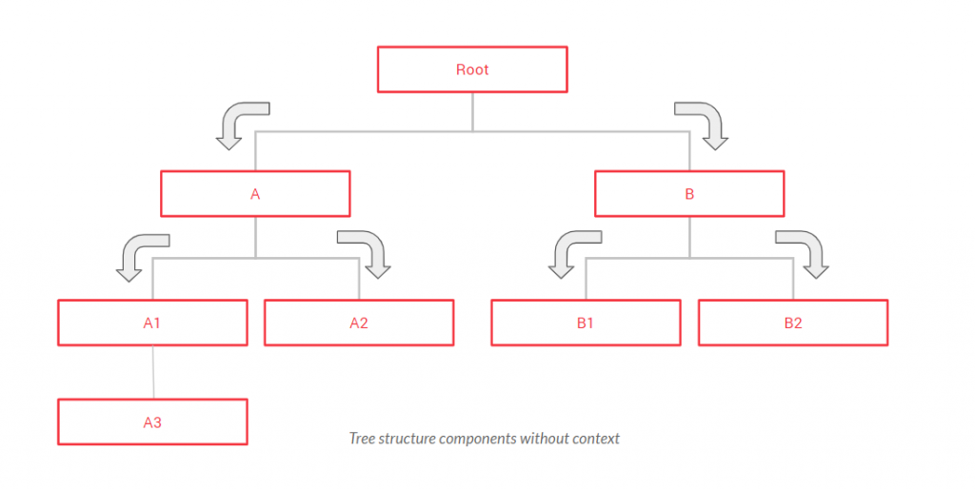
React Architecture

Slide 9
Installation
https://reactjs.org/docs/create-a-new-react-app.html
Install Node.js with default settings
Run the command npx create-react-app appname
Change directory to appname cd appname
Run the command npm start
Enjoy!

Slide 10
Components, State and Props

Slide 11
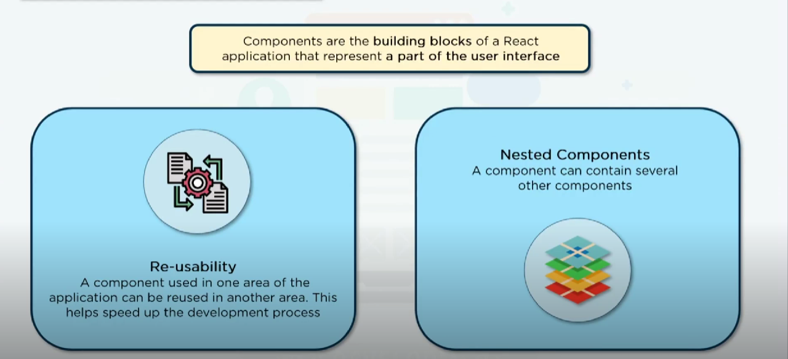

Slide 12
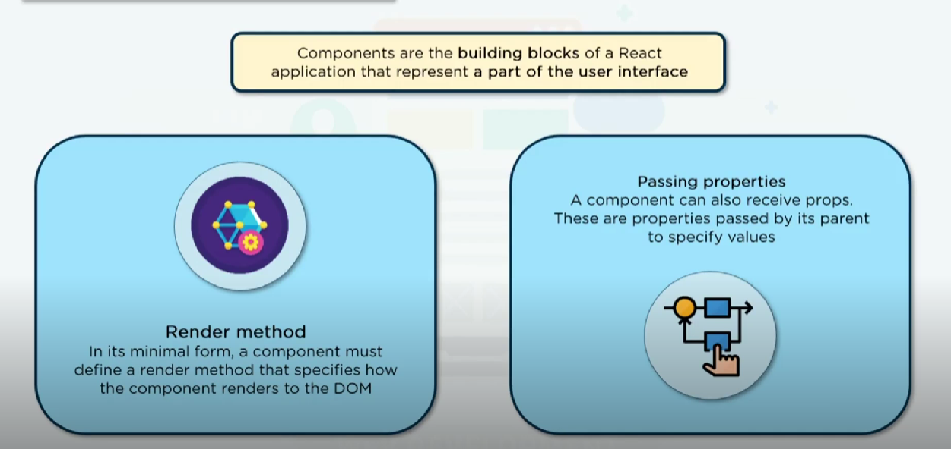

Slide 13
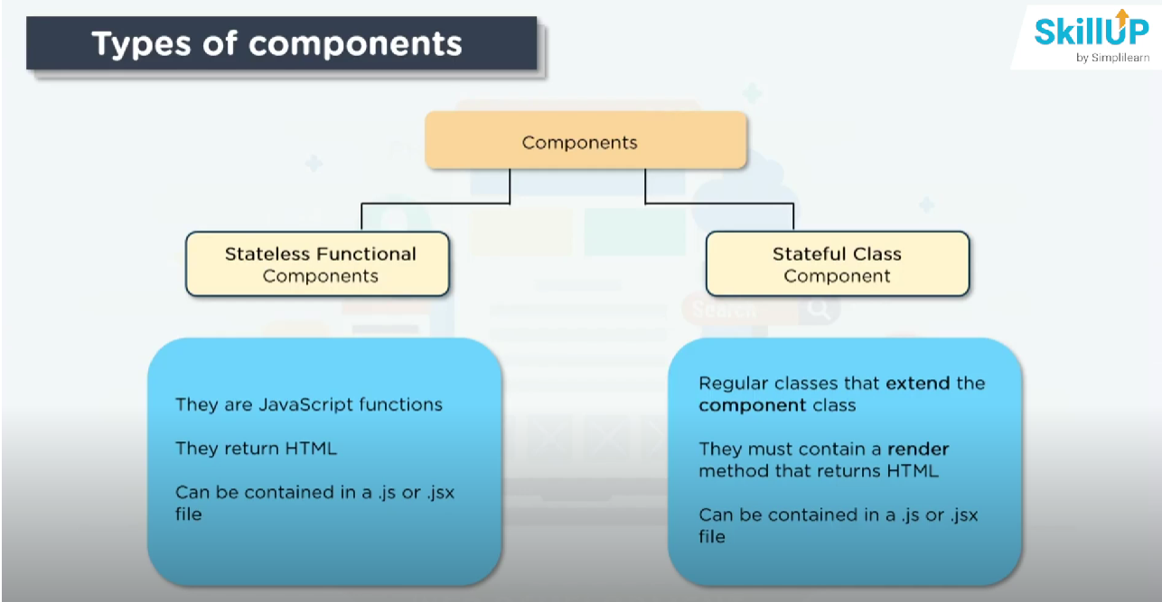

Slide 14
Class Components
The class components are a little more complex than the functional components
On a demise, not used on a large scale.

Slide 15
Functional Component
Functional components are simply javascript functions. We can create a functional component in React by writing a javascript function. These functions may or may not receive data as parameters
we can compose multiple functional components under a single functional component

Slide 16
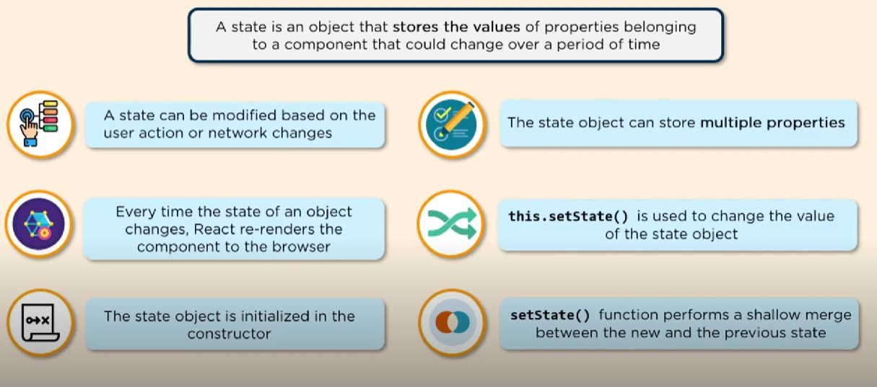
State

Slide 17
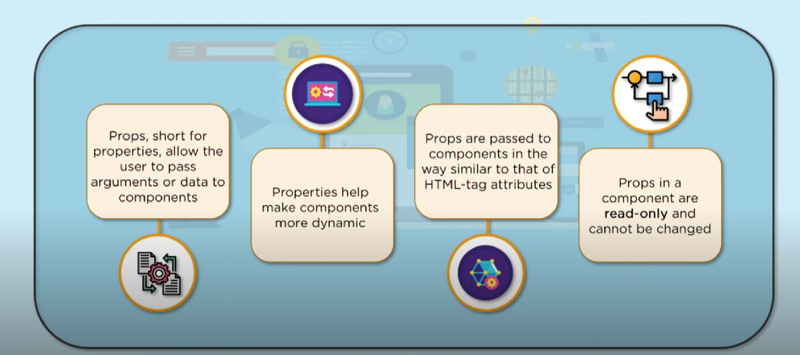
Props

Slide 18
Conditional Rendering
Map
Filter

Slide 19
Event Handling

Slide 20
Event Handlers
onClick
onSubmit
onMouseOver
onMouseOut

Slide 21
Forms

Slide 22
Forms in React
Form tags
How to get values from form fields
Form methods
useRef

Slide 23
React Routing

Slide 24
React Router Dom
● Router
● Routes/Switch
● Route
● Link tag
● useHistory/ useNavigate
● useLocation

Slide 25
Happy Coding !

Slide 26
References
https://react.dev/
https://www.w3schools.com/react/react_components.asp
https://legacy.reactjs.org/
https://www.geeksforgeeks.org/what-are-the-differences-between-npm-and-npx/
https://reactrouter.com/en/main/routers/create-browser-router

Slide 27
Thank You

